Slide 1
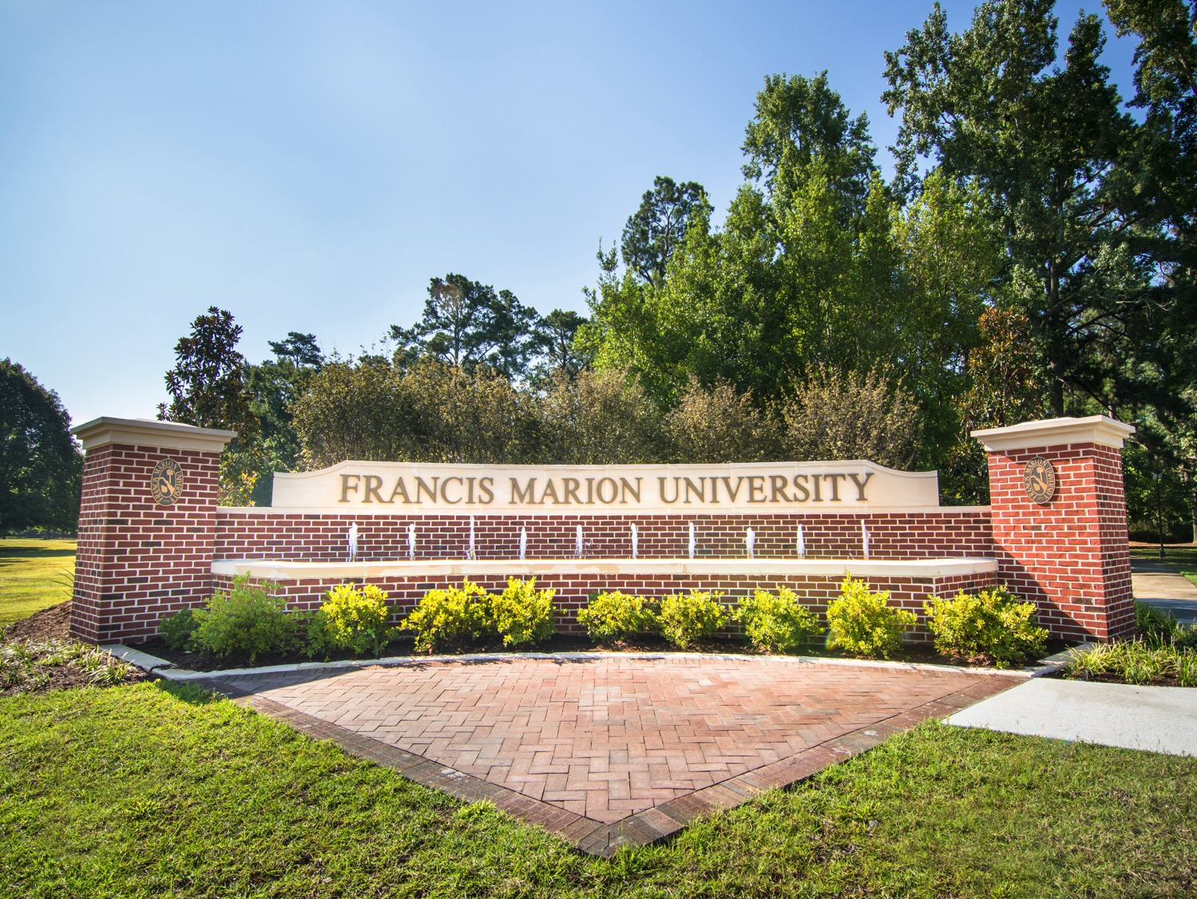
FRANCIS MARION UNIVERSITY
House Ways & Means Higher Ed & Tech College Subcommittee
Budget Meeting for FY2019-20

Slide 2
Highlights
Current Accomplishments:
Graduated the first class of Doctor of Nursing Practice (DNP) students in Fall 2018 (7).
Began our first Speech Language Pathology Program in fall 2018 (25).
Admitted our second class of Physician Assistant Students in fall 2018 (32).
Broadened the effort of our Center for Academic Success and Advisement (CASA) in the retention and academic success of our students through implementation of programs such as Early Alert and Patriot Mentors.
Completed the accreditation reaffirmation off-site and on-site reviews from SACSCOC and received full accreditation.
Current Goals:
Begin new Mechanical Engineering Program in Spring 2020.
Continue to develop health and medical science programs to meet the employment needs of health care delivery providers through the northeastern region of the state.
Enhance student programming initiatives on campus.
Continue cooperative programs such as the Pee Dee Health Education Partnership, the FMU and City of Florence North Dargan Innovation Center, and FMU’s Patriot College with Pee Dee Education Consortium (17 school districts).
2
Notes:
Information as provided by the Accountability Report and reported previously on the EBO/Governor’s Budget Hearing Presentation.

Slide 3
Appropriations History (3 Yrs.)
Total Funds | 65,628,696 | 67,603,417 | 78,757,657
FY18-19 Note: Recurring allocations of $157,458 for health and dental insurance and $110,108 for retirement have been received in addition to a non-recurring retirement credit of $308,650 was received but not included in the chart above.
3
Notes:
THIS SLIDE ONLY RECONCILES TO THE APPROPRIATION ACT.
State Recurring take into consideration 1A funds.
This slide does not take into consideration Budget Carryforwards (unlike Slide 7), Capital Reserve Funds, Lottery Funds, nor mid year appropriations for COLA’s, Health Ins., Etc. that were received during the 3 years.

Slide 4
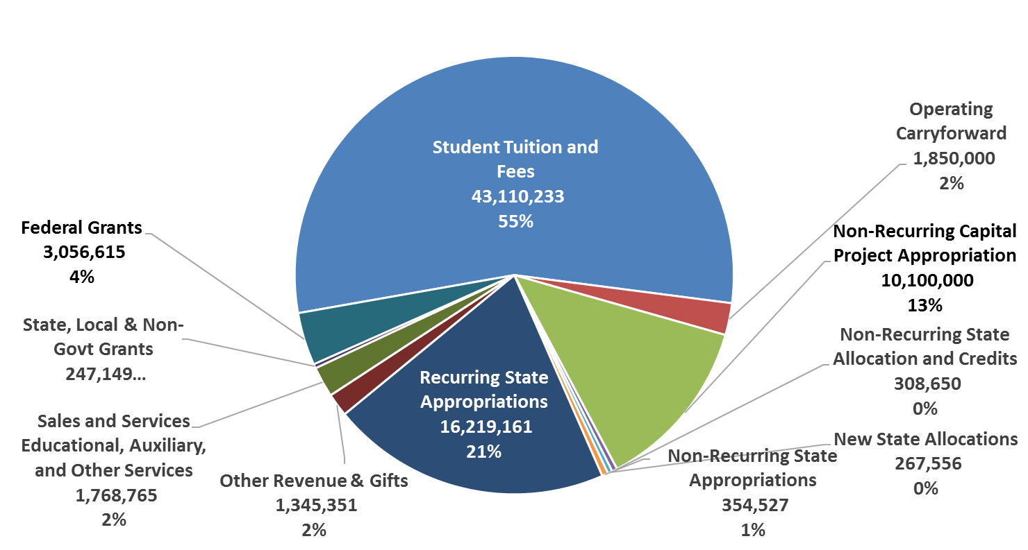
Current Revenue FY18-19
Total Available Resources = $78,628,006
4
Notes:
Presentation is:
Net of Fed., State, Other Scholarship Waivers.
Does not include depreciation as this is not an expense that goes against our state authorization limits.
Reconciliation of Resources to State Fund Authorizations (slide 6)
Total Available Resources: $67,977,378
Less: Operating Carryforward: $1,935,901
Less: Non-Recurring Carryforward: $1,154,735
Less: State Allocations and Other NR Res.: $ 843,356
Adjusted Available Resources: $64,043,386
State Authorization $65,628,696
Unused State Authorization $ 1,585,310

Slide 5
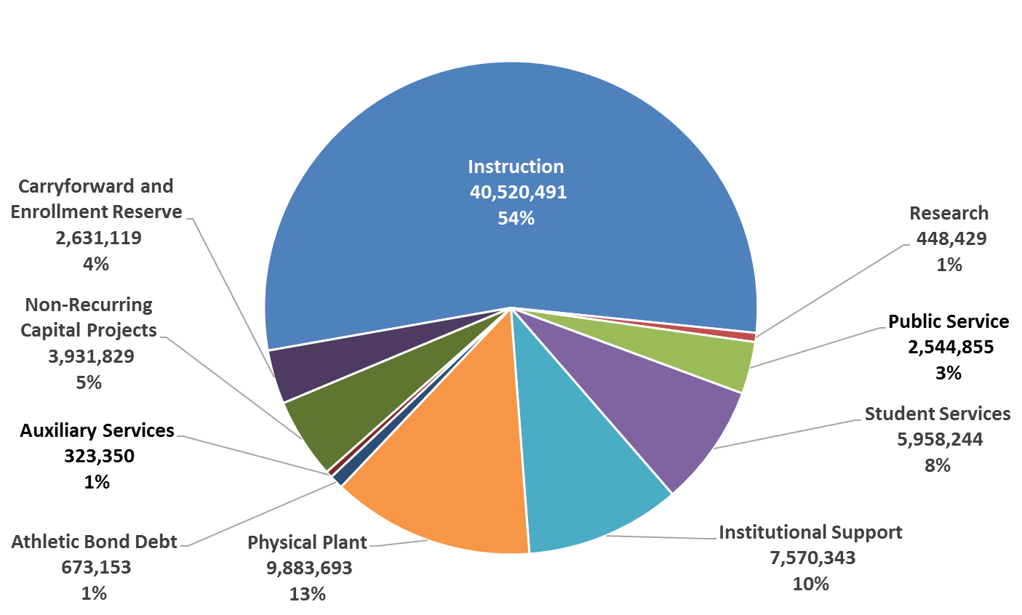
Current Expenditure Budget FY18-19
FY18-19 Operating Expenditures = $74,485,506
5
Notes:
Slide lumps Instruction, Academic Support, and Scholarships into one category.

Slide 6
Cash Carry Forward
 | 2016-17 | 2017-18 | Est 2018-19 | Carry Forward Explanation
Recurring Appropriations | $0 | $0 | $0 | N/A
Non-recurring Appropriations | $0 | $0 | $0 | N/A
Other Funds | $11,830,890 | $11,073,835 | $12,163,335 | We anticipate an increase in cash carryforward this year which will primarily come from operations and be used to cover several maintenance projects slated for the year. The majority of the cash carryforward is due to the University’s maintenance carryforward account. The balance is estimated to be the operating residual (unrestricted and designated) of the University. We have approximately 20 business days unrestricted operating cash (exclusive of maintenance reserve funds and designated funds) on hand projected at year end.
Federal Funds | $0 | $0 | $0 | N/A
Total Carry Forward | $11,830,890 | $10,958,539 | $12,163,355 | N/A
9
Note: This report does not include cash held for capital projects.

Slide 7
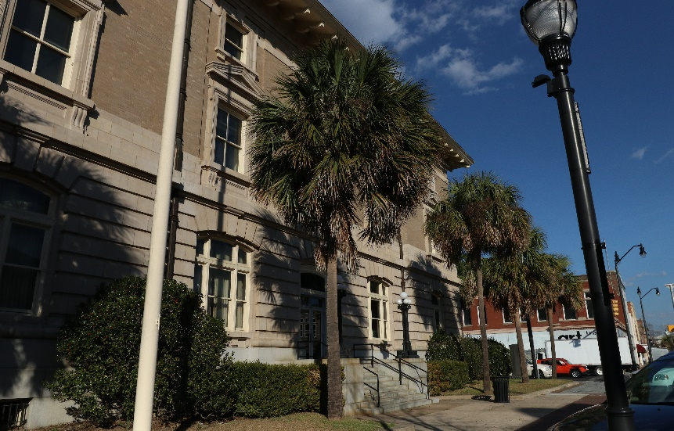
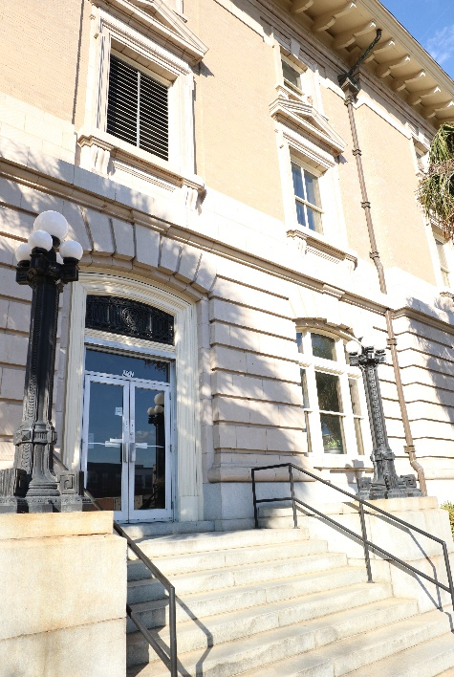
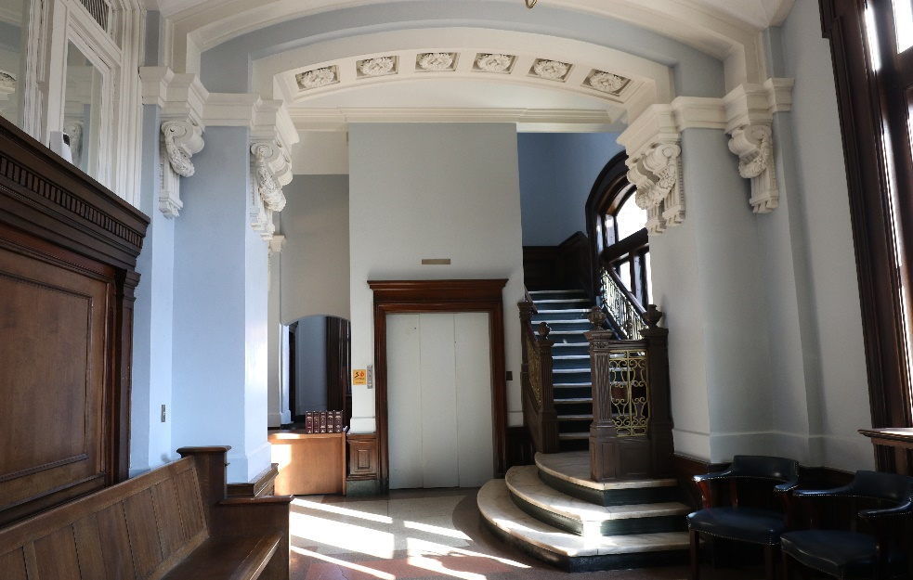
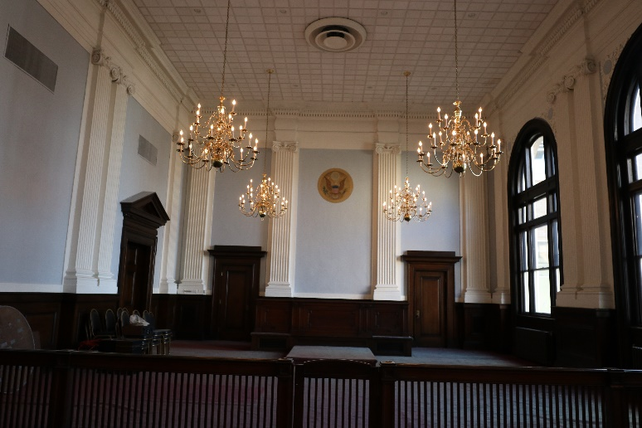
Capital Projects
Medical Education Complex
Phase II A-1 in process.
Current Funding
$8,000,000 Project Cost
$8,000,000 Revenue Received
$ 0 Funds Needed
Project Expenditures
$8,000,000 Funds Available
$ 0 expended
$8,000,000 Project Fund Balance
7

Slide 8
Capital Projects cont’d
Honors Learning Center
Phase II A-1 in Process
Funding Status
$3,155,932 Total Project Cost
$3,155,932 State Funding Received
$ 0 Funds Needed
Project Expenditures
$3,155,932 Funds Currently Available
$ 24,000 Expended
$3,131,932 Project Fund Balance
8

Slide 9
Deferred Maintenance
The University has the 2017 Campus Master (adopted June 2017) which is a continuation of the 2012-2020 Master Plan. This plan acts as a consolidated capital and maintenance plan.
In FY 17-18, FMU spent $2,342,174 on general maintenance needs and has spent an additional $372,032 on ongoing deferred maintenance projects totaling $1,154,735.24
Project | Source of Funds | Status | % Completion
Library HVAC & Library 201 Renovation | 2011-12 SC Capital Reserve | Close-out A-1 Being Prepared. | 100% Complete
Founders Hall Renovation Phase 1 | 2013-14 SC Lottery Funds | Open / Active | 90% Complete
Founders Hall Renovation Phase 2 | 2014-15 Proviso 118.16 | Open / Active | 74% Complete
Classroom Renovation | 2014-15 Proviso 118.16 | Closed | 100% Complete
Critical Equipment Repair and Replacement | 2014-15 SC Lottery Funds via CHE | Open / Active | 89% Complete
Energy Efficiency Funds | FY14-15 Proviso 118.16 Efficiency Funding | Open / Active | 68% Complete
9

Slide 10
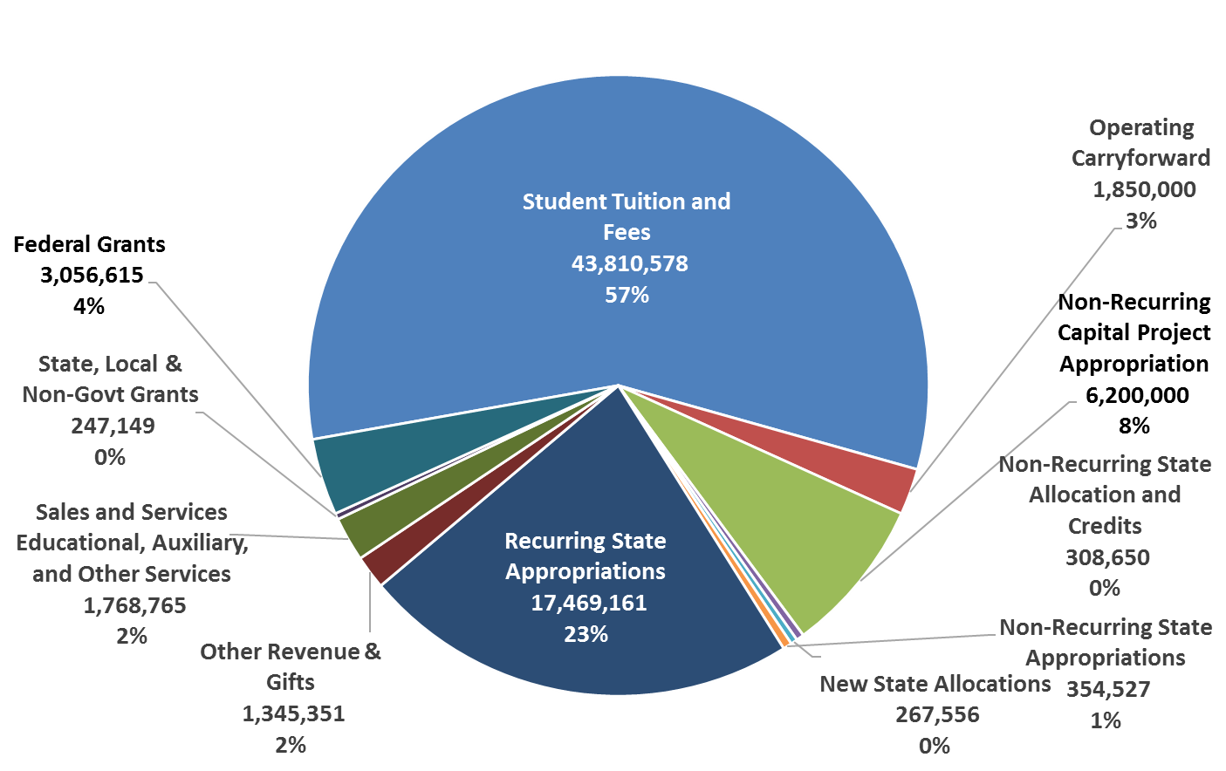
Anticipated Funding FY 19-20
Total Anticipated Resources = $76,678,351
10
Notes:
This model assumes the PA program will enroll 32 in Fall.
This model also assumes the Speech Path Program will enroll 20 in Fall.
This model does not include an enrollment of class 2 in Speech Path program prerequisites in Spring 2019.
This model does not assume we will again receive a 1% PEBA credit for retirement fringes as we did in FY17-18.

Slide 11
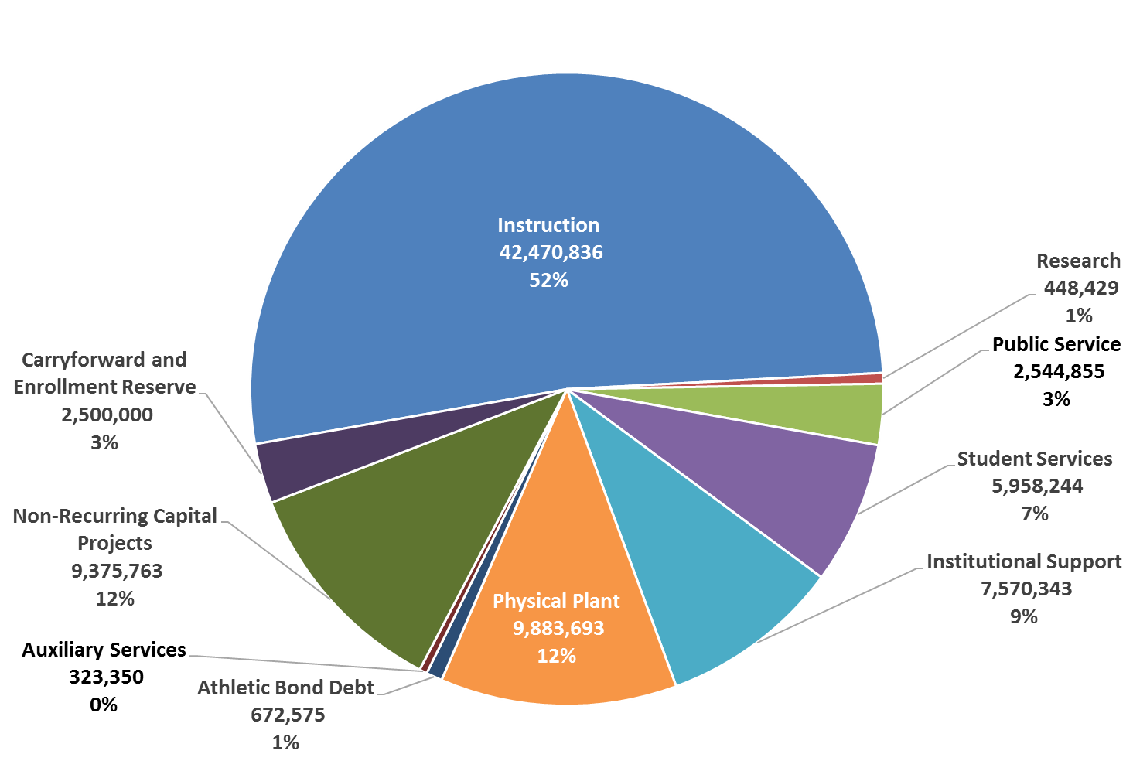
Anticipated Expenditure Budget FY 19-20
FY19-20 Operating Expenditures = $81,748,088
11

Slide 12
Recurring Appropriations Request FY 20
Request | Amount Requested | Description of Request
Priority #1 – Mechanical Engineering | $750,000 (4 FTEs) | Justification: This new program will address the need for mechanical engineers across the region. It will build upon existing programs in industrial engineering and physics. A number of manufacturers in our region have indicated that they have difficulty hiring and retaining mechanical engineers. As 95% of our students are South Carolina residents, with 40% living in the Pee Dee, this program will address the need for engineers by educating local residents more likely to remain in the region after graduation. Methodology: This request addresses objective 1.1.3 by providing base funding for a Mechanical Engineering Program. The funds will be used to support the program with new faculty members and administrative support for the program. The use of these funds will be evaluated on the ability to start the program and sustain future enrollment success. Potential Offset: All potential offsets have been considered for this request.
12

Slide 13
Recurring Appropriations Request FY 20 cont’d
Request | Amount Requested | Description of Request
Priority #2 – Behavioral Health Clinic | $500,000 (4 FTEs) | Justification: The Behavioral Health Instructional Clinic is an important extension of the Master of Science in Applied Psychology program. This program has 3 tracks: Applied Behavioral Analysis, Clinical Psychology and School Psychology. The clinic will operate in partnership with Hope Health, a growing community health center in Florence and will provide critically needed assessment and treatment care for behavioral health patients. The clinic will also provide opportunities for all other health science students, including nurses, nurse practitioners, physician assistants and speech-language pathologists to gain valuable experience as they rotate through the clinic. Experience with behavioral health patients is important not just for behavioral health professionals but for all health care practitioners. Methodology: This request addresses objective 4.1.5 in establishing a behavioral health clinic program. The use of these funds will be for staffing of the clinic and will be evaluated on the ability to begin and sustain enrollment success in the program. Potential Offset: All potential offsets have been considered for this request.
13

Slide 14
Non-Recurring Request FY 20
Request | Amount Requested | Description of Request
Priority #4 – Road and Infrastructure Repair and Renovation | $2,200,000 | Justification: With Francis Marion University nearing its fiftieth anniversary, we are experiencing the first major phase renovation of original infrastructure. Roads and parking lots are an essential priority. Methodology: .Maintenance and deferred maintenance needs are a constant on any campus. These funds will be used to address the highest priority infrastructure needs on campus, our roads. Potential Offset: All potential offsets have been considered for this request.
14

Slide 15
Capital Requests FY 20
Request | Amount Requested | Description
Priority #3 – Freshwater Ecology Research Center | $4,000,000 | Justification: The proposed freshwater ecology center will be a 12,000 sq. ft. instructional and research resource to serve the northeastern region of the state. The complex will be built on the northern edge of a 20 acre lake that will be used for research and educational purposes. Freshwater is becoming one of the most valuable resources in need of protection. Increasing population growth increase the level of pollutants and contaminants in the region’s rivers and wetlands. The freshwater ecology center and its laboratory will provide space for scientists to study freshwater quality and community ecology of 4 rivers, lake, and streams and educate undergraduate students who might choose such areas for careers. Methodology: 145 acres of land, including the 20 acre lake, are being gifted to the University. This provides the University an opportunity to enhance our biology & ecology programs and provide long term benefit to sustaining the natural resources of the Pee Dee region. The facility’s success will be assessed on the data derived from its laboratory. Potential Offsets: There are no potential offsets for this request.
15

Slide 16
Other Funds Request FY 20
Request | Amount | Revenue Source | Description
Priority #5– Speech Pathology Program Year 3 | $700,345 (3 FTEs) | Student Tuition Revenue | FMU will enroll its third class for the Speech Language Pathology Program in Fall 2019. The class of 25 will generate $700,345 in tuition revenue.
16

Slide 17
Federal Funds Request FY 20
At this time, FMU does not have any federal funding requests for FY20.
17

Slide 18
FTE Request
Request | FTEs Needed | Revenue Source | Description
Mechanical Engineering | 4 FTEs | Recurring Appropriation Request | FTEs will be for faculty to administer the program.
Behavioral Health Clinic | 4 FTEs | Recurring Appropriation Request | FTEs will be for faculty and staff for the clinic and clinical psychology program.
Speech Pathology Year 3 | 3 FTEs | Other Funds Authorization Request | FTEs will be for additional faculty to handle the increase in students entering the program.
Proviso 11.14 Compliance: FMU inquired of CHE if the Executive Budget Office (EBO) had been in contact in regard to the FTEs requested. As of 12/5/18, CHE had not received correspondence from the EBO in regard to such.
18

Slide 19
Provisos
Proviso # | Disposition | Purpose & Justification
1A.32 | Keep | Allocation of $350k to the Center of Excellence to prepare teachers of children of poverty. This program is key to the Pee Dee as teachers in this region are significantly more likely to teach children from impoverished areas.
3.6 | Keep | IT funding for higher ed. These funds further enhance technology support across the campus.
17.1 | Remove | Funds have been transferred as provided, thus rendering this proviso moot.
General Higher Ed Provisos
117.7(B)(2) | Keep | Exempts university fee increases from having to be approved legislatively.
117.8 | Keep | This proviso is essential in allowing institutions to retain tuition revenues generated by the University to reinvest in the institution and to provide general reserves to assist in enrollment fluctuations and capital maintenance.
117.11 | Keep | Allows institution’s board to set fees and define fee categories.
117.16 | Keep | Disallows fixed allowances for personal expenses to presidents.
117.28 | Keep | Regulates state operated day care facilities.
Cut and paste ALL of the institution’s applicable provisos (this should include all general provisions (section 117s) and lottery provisions that affect the institution as well) and indicate the action requested for each with an explanation of such action. (Keep, Amend, Delete, or Codify)
If the action is to amend, provide the new language.
Please provide all new proviso language at the end of this section.
FMU did not comment on CHE specific provisos or proviso requiring statewide administrative reporting which FMU is required to participate in.
19

Slide 20
Appendix
20

Slide 21
Student Enrollment cont’d
3yr History
21

Slide 22
Student Enrollment
Newly Enrolled Freshmen Applied, Accepted, & Enrolled
22

Slide 23
Student Enrollment cont’d
23
Notes:
THIS IS REPORTED BY HEADCOUNT.
FTE WOULD NOT HAVE YEILDED SIGNIFICANTLY DIFFERENT RESULTS.
In-state / Out-of-State Enrollment
In-state – 3,590
Out-of-State – 131
International – 65

Slide 24
Student Enrollment cont’d
Enrollment by Major
Note: Enrollment by major includes pre-professional programs.
24
Notes:
THIS IS REPORTED IN HEADCOUNT ONLY. WE COULD NOT REPORT BY FTE AS REQUESTED.
Only Health Sciences include pre-professional programs.

Slide 25
Student Enrollment cont’d
17.2% Graduated From FMU
32.8% Still at FMU
24.4% Still at Another Institution
15.1%
5.5%
36.8%
22.7%
74.2%
41.1% Graduated From FMU
13.4% Graduated From Another Institution
40.4%
12.5%
4.9%
12.2% Still at Another Institution
11.6%
69.7%
25
FMU alumni currently residing in-state: 17,040 of 22,637.

Slide 26
Tuition & Required Fee History
 | FY2014-15 Increase | FY2015-16 Increase | FY2016-17 Increase | FY2017-18 Increase | FY2018-19 Increase
Tuition Increase | 3.20% | 3.30% | 3.30% | 3.00% | 2.00%
Required Fee Inc. | 15.70% | 12.70% | 3.00% | 21.20% | 12.70%
26
Notes:
Required Fees increased at a higher % due to the relative size of the fee and due to the increasing need to cover direct IT and Maintenance of the University Facilities that are covered in part due to required fees for IT and Facility.

Slide 27
Tuition Calculation
Fall 2018 Tuition and Required Fees (Per Semester)
 | In-State Undergrad | Out-of-State Undergrad | In-State Grad | Out-of-State Grad | Upper Division (Nursing & Engineering) In-State Undergrad | Upper Division (Nursing & Engineering) Out-of-State Undergrad | Nursing In-State Grad | Nursing Out-of-State Grad | PA & Speech Pathology Programs In-State | PA & Speech Pathology Programs Out-of-State
Education & General | $5,092 | $10,284 | $5,206 | $10,512 | $8,018 | $16,136 | $8,132 | $16,364 | $9,664 | $19,428
Plant Improvement | $100 | $100 | $100 | $100 | $100 | $100 | $100 | $100 | $100 | $100
Total Tuition | $5,192 | $10,384 | $5,306 | $10,612 | $8,118 | $16,236 | $8,232 | $16,464 | $9,764 | $19,528
Registration | $20 | $20 | $20 | $20 | $20 | $20 | $20 | $20 | $20 | $20
Student Activity Fee | $156 | $156 | $156 | $156 | $156 | $156 | $156 | $156 | $156 | $156
Information Tech. Fee | $112 | $112 | $112 | $112 | $112 | $112 | $112 | $112 | $112 | $112
Facility Fee | $100 | $100 | $100 | $100 | $100 | $100 | $100 | $100 | $100 | $100
Total Tuition and Required Fees | $5,580 | $10,772 | $5,694 | $11,000 | $8,506 | $16,624 | $8,620 | $16,852 | $10,152 | $19,916
27

Slide 28
Scholarships & Grants
Type of Aid
Recipients
Total Awards
Federal Pell Grant
1,935
$ 8,889,350
Federal SEOG Grants
150
$ 134,980
HRSA Federal Nursing Grant
157
$ 1,077,788
Vocational Rehabilitation Grants
28
$ 107,151
Federal Grants and Scholarships
2,270
$ 10,209,269
HOPE Scholarship
242
$ 609,642
LIFE and LIFE Enhancement Scholarship
1,037
$ 5,596,507
Palmetto Fellows and PF Enhancement
Scholarship
71
$ 530,843
SC Need-based Grant
1,270
$ 1,229,228
SC National Guard Assistance Program
90
$ 709,366
Lottery and State Grants and Scholarships
2,710
$ 8,675,586
FMU scholarships(academic, athletic,
foundation)
1,028
$ 5,752,777
Total Grants and Scholarships
6,008
$ 24,637,632
28

Slide 29
Outstanding Debt Report as required by Proviso 11.16
Series 2009A Athletic Facilities Revenue Bonds
Initial Debt: | $8,500,000
Total Interest: | $5,114,391
Year Incurred: | 2010
Pay Off Date: | 06/30/2030
Purpose: | Construction of Athletic Complex
Ave. Annual Coupon Rate: | 4.98%
Average Annual Principal Expense: | $425,000
Average Annual Interest Expense: | $255,720
Average Annual Debt Service Expense: | $680,720
29

Slide 30
Employee FTEs
FTEs
 | Authorized | Filled | Vacant
State | 295.18 | 293.55 | 1.63
Federal | 0.75 | 0.00 | 0.75
Other | 175.43 | 164.38 | 11.05
Total | 471.36 | 457.93 | 13.43
Vacancies to be filled in FY18-19 – 12.875 FTE
Headcount - The University has 585 employees with an estimated payroll totaling $30,965,951
Full Time Faculty = 206 Part Time Faculty = 76
Full Time Staff = 301 Part Time Staff = 2
30

Slide 31
Student to Faculty Ratios
Student to Faculty Ratio by Enrollment in Program
Humanities & Social Sciences | 12:1
Health Sciences | 39:1
Business | 22:1
Education | 30:1
Natural Sciences & Engineering | 11:1
Student to Faculty Ratio
17:1
Student to Faculty & Staff Ratio
8:1
31

Slide 32
Employee Demographics
32
Notes:
Administration includes Department Directors, Academic Chairs, Deans and Associate Deans, and All Senior Staff.

Slide 33
4% Tuition Waiver & Abatements
 |  | FY15-16 |  |  | FY16-17 |  |  | FY17-18
Program | Level | Students | R | NR | Students | R | NR | Students | R | NR
4% Waivers | Freshman | 5 | 5 | 0 | 1 | 1 | 0 | 0 | 0 | 0
 | Sophomore | 45 | 45 | 0 | 18 | 18 | 0 | 6 | 6 | 0
 | Junior | 13 | 13 | 0 | 13 | 13 | 0 | 5 | 5 | 0
 | Senior | 38 | 38 | 0 | 19 | 17 | 2 | 17 | 17 | 0
 | Other | 1 | 1 | 0 | 0 | 0 | 0 | 21 | 21 | 0
 | Total | 102 | 102 | 0 | 51 | 49 | 2 | 49 | 49 | 0
Full Abatements | Freshman | 8 |  | 8 | 14 |  | 14 | 50 |  | 50
 | Sophomore | 35 |  | 35 | 34 |  | 34 | 13 |  | 13
 | Junior | 31 |  | 31 | 29 |  | 29 | 34 |  | 34
 | Senior | 60 |  | 60 | 56 |  | 56 | 55 |  | 55
 | Other | 16 |  | 16 | 14 |  | 14 | 7 |  | 7
 | Total | 150 |  | 150 | 147 |  | 147 | 159 |  | 159
4% Waiver Methodology: All waivers are provided based on academic merit or financial need. Waivers are used as a supplement to the FMU scholarship programs.
33
Note: FMU has not offered partial abatements in the three year period covered.
Notes:
Internationals and Out-of-Staters = 196
We abated the out-of-state differential for = 147
Only 25% of our Out-of-Staters pay a portion or all of the out-of-state differential

Slide 34
Criterion for Merit Award Abatements
Policy Pursuant to 59-112-70 (A):
A non-resident receiving scholarship/grant for a minimum of $250 per semester receives an abatement, allowing the student to pay-in-state tuition and fees for that semester. Should any student receive such an abatement in fall and spring they become eligible for summer session abatement.
FMU only awards full abatements if award criteria are met. No partial abatements were awarded this year or in recent years.
FY2018-19 Merit Awards: Non-resident Non-resident Athlete
Students Receiving Abatements: 65 78
Average Annual Student Abatement: $ 5,108 $ 5,167
34

Slide 35


Slide 36
